Slide 1
Angular 6
By : Akash Kale

Slide 2
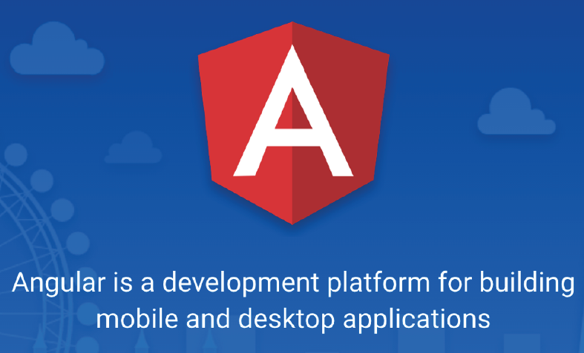

Slide 3
Angular 6
Angular allows you to develop single page applications which reload only the part of the page when user interacts with the page by clicking on a link or a button.
Angular uses components to display the content on the page and these components are replaced by other components at runtime when user wants to see other contents while interacting with the page.

Slide 4
Continue...
Angular is a framework for building client applications using HTML and Typescript (a super set of JavaScript) which is compiled to JavaScript.
Angular JS 1.x was limited to a framework to build only web applications, whereas Angular 2 or later has grown into a strong platform which allows you to develop fast and scalable applications across all platforms such as web, mobile web, native mobile and native desktop.

Slide 5
SPA Vs MPA
SPA means Single Page Application
MPA means Multiple Page Application
Faster navigation
Improved user experience
Decoupling of front-end and back-end development

Slide 6
Angular 6 setup
Setting up and configuring angular project takes time as it involves adding lot of
JS libraries
Compiler to Typescript
Configuring server etc
So Angular team has provided a high quality development toolset to ease the application set up and configuration one such toolset you can use is Angular CLI (Command Line Interface) which automate your development workflow.

Slide 7
Angular CLI
Create new angular application.
Run a development server with a LiveReload support to preview your application during development.
Add features to your existing angular application
build deployment and production ready application
Run your application’s unit tests
Run your application’s end to end tests(E2E tests)

Slide 8
Pre-requisites for Angular 6
HTML/HTML5
CSS/CSS3
JavaScript
TypeScript
Web Technologies (Servlet/JSP, PHP, ASP.net – Optional)

Slide 9
Software’s required
Node.js 6.9.0 or later
NPM 3.0 or later (comes with Node.js).
Editor Visual Studio Code or Brackets or Sublime.

Slide 10
Why node.js ?
“Node's goal is to provide an easy way to build scalable Network programs”

Slide 11
What is NodeJS ?
NodeJS is an open source , cross platform runtime environment for server side and networking application.
It is written in JavaScript and can run on Linux , Mac ,Windows , FreeBSD.
It provided an event driven architecture and a non blocking I/O that optimize and scalability. These technology uses for real time application.
It used Google JavaScript V8 Engine to Execute Code.
It is used by Groupon, SAP , LinkedIn ,Microsoft,Yahoo ,Walmart ,Paypal.

Slide 12
What is unique about Node.js?
JavaScript used in client-side but node.js puts the JavaScript on server-side thus making communication between client and server will happen in same language
Servers are normally thread based but Node.JS is “Event” based. Node.JS serves each request in a Event loop that can able to handle simultaneous requests.
Node.JS programs are executed by V8 JavaScript engine the same used by Google chrome browser.
Notes:
Thread based servers like Apache server will serve each web request as individual threads which doesn’t fit well for concurrent connections.

Slide 13
Node.js is not……
● Another Web framework
● For beginner
● Multi-thread
In Simple Node.js
Node.js = Runtime Environment + JavaScript library.

Slide 14
Why node.js ?
● Non Blocking I/O
● V8 JavaScript Engine
● Single Thread with Event Loop
● 40,025 modules
● Windows, Linux, Mac
● 1 Language for Frontend and Backend
● Active community

Slide 15
Why JavaScript ?!!!
Friendly Callbacks
Ubiquitous
No I/o Primitives
One language to RULE them all
JavaScript is well known for client-side scripts running inside the browser
node.js is JavaScript running on the server-side
SSJS -> Server-Side JavaScript
Use a language you know
Use the same language for client side and server side

Slide 16
Angular 6

Slide 17
The Main Building Blocks
Module
Component
Metadata
Template
Data Binding
Pipes
Service
Directive
Dependency Injection

Slide 18
Installation of Angular
ng
npm install –g @angular/cli
ng version
ng new projectName
cd projectName
npm start

Slide 19
Metadata (with decorators)
Decorators are functions that modify JavaScript classes.
Angular has many decorators that attach metadata to classes so that it knows what those classes mean and how they should work.
Decorators like a annotation in Java Technology

Slide 20
Few angular 6 decorator
Pre-defined decorator
@NgModule
@Component
@Injectable
@Input
@Output
Each decorator accepts a well-defined, specific configuration object that contains information about the class or property to be decorated.

Slide 21
Modules
Angular applications are composed of modules.
Modules contain AngularJS objects (components, directives and pipes) and also our own app’s objects.
The binding points between modules are the imports and exports.
“In Angular a module is a mechanism to group components, directives, pipes and services that are related, in such a way that it can be combined with other modules to create an application.”

Slide 22
Continue...
Technically, a module is a class with a decorator (@NgModule) that has the information of:
Which components, directives and pipes belong to the module (declarations)
Which components do you want to start first mention in (bootstrap).
Which other existing modules will be used to accomplish tasks (imports)
Which of those components, directives and pipes are allowed to be used by other modules (exports)
Provide services that are going to be used by inner objects(providers)

Slide 23
Module syntax
import { NgModule } from '@angular/core';
@NgModule({
imports: [ ... ],
declarations: [ ... ],
providers:[...],
exports:[....],
bootstrap: [ ... ]
})
export class AppModule { }

Slide 24
Components
A component is a class that controls a specific part of the screen, called the view.
A component may be a single file with everything bundled in, including css and html, or can split those (usually large) sections into separate css and html files.
The configuration object in the @Component decorator will indicate how to find each part.
“Angular component are a subset of directives. Unlike directives, components always have a template and only one component can be instantiated per an element in a template”

Slide 25
Component Syntax
import { Component } from '@angular/core';
@Component({
selector: 'app-root',
templateUrl: './app.component.html',
styleUrls: ['./app.component.css']
})
export class AppComponent {
title = ‘app';
}

Slide 26
Bootstrapping an application
To boot strap our module based application, we need to inform Angular which is the Root Module.
The main.ts is the entry point script an angular would search to bootstrap the module.

Slide 27
Sample of main.ts
import { enableProdMode } from '@angular/core';
import { platformBrowserDynamic } from '@angular/platform-browser-dynamic';
import { AppModule } from './app/app.module';
import { environment } from './environments/environment';
if (environment.production) {
enableProdMode();
}
platformBrowserDynamic().bootstrapModule(AppModule)
.catch(err => console.log(err));

Slide 28
Understanding the File structure:-
app/app.component.ts – This is where we define our root component
app/app.component.html --This is the template or html page where we write presentation logic
app/appcomponent.css --This is the css file where we can write formatting style
app/app.module.ts – The entry Angular Module is bootstrapped
index.html – This is the page the component will be rendered in
app/main.ts – This the glue that combines the component and page together

Slide 29
Data binding
Data binding is the connection bridge between view and the business logic (View Model) of the application.
Data binding in Angular is the automatic synchronization between model and the view.
When the Model changes, the view are automatically updated and vice-versa.

Slide 30
We can achieve totally four ways
Interpolation
One way binding
Event binding
Two way binding

Slide 31
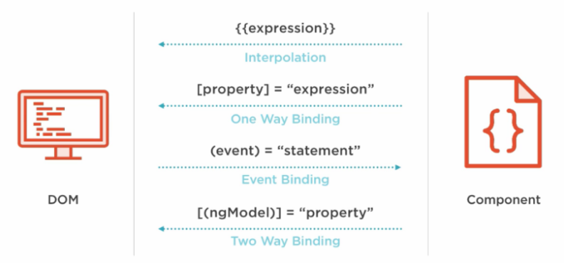

Slide 32
Interpolation
This is the easiest way of data binding in Angular JS. This is same as expression in Angular 1.x. In interpolation.
we need to supply property name is the view template, enclosed in double curly braces, eg. {{name}}.
It is used for one-way binding (Component class to View only).

Slide 33
Property binding
Property binding also known as one – way data binding.
Property binding use [] to send value from the Component to the template(View).
The ng-bind directives is used for one-way binding in Angular 1.x.
Angular 2 uses HTML DOM element property for one-way binding. The square brackets are used with property name for one-way data binding in Angular 2.
<p>Welcome to <span [innerText]="title"></span></p>
Enter Full Name :<input type="text" [value]="fullName">

Slide 34
Interpolation Vs Property binding
String interpolation - {{expression}} - render the bound value from component's template and it converts this expression into a string.
Property binding - [target]="expression" - does the same thing by rendering value from component to template.
But if you want to bind the expression that is other than string (for example - boolean), then property binding is the best option.

Slide 35
Two – way binding
The ng-model directives is used for two-way binding {{ }} in Angular 1.x,
But it is replaced with [(ngModel)] in Angular 2.0. The ngModel directive is part of the build-in Angular module called "FormsModule".
So, we must import this module in to the template module before using the ngModel directive.
<input [(ngModel)]="userName">
The User Name is {{userName}}

Slide 36
Event Binding
Angular 2.0 directly uses the valid HTML DOM elements event. For example, ng-click is now replaced by (click).
The round brackets (parentheses) are used with DOM event name for event binding in Angular 2.
(click)
(dblclick)
(mouseenter)
(mousedown)
(keyup)
(keydown)
(submit) etc

Slide 37
Two – way binding without ngModel
Angular 2 has feature called "template reference variables". With this features.
We are able to have directive access to an element. The template reference variable is declared by preceding an identifiers with a hash/pound character (#).
With reference template is completely self-contained and it doesn't bind to the component.
This solution will not work unless we bind to the element's event.
<input #userName type="text" (keyup)="0">
The User Name is {{userName.value}}

Slide 38
Angular JS directives
Directive allow you to attach behaviour to element in the DOM.
There are three types of directives
Component directive : directives with a template
Structural directive : change the DOM layout by adding and removing DOM elements.
Attribute directive : change the appearance or behaviour of an element, component or another directive.

Slide 39
Component directives
Angular component are a subset of directives. Unlike directives, components always have a template and only one component can be instantiated per an element in a template.
The specific type of directive that allows us to utilize web component functionality encapsulated, reusable elements available through our application.

Slide 40
Component directive
We can create a component like so
@Component({
selector:"my-component",
tempalte:"<p>This is user defined component</p>”
})
export class MyComponent {}

Slide 41
Structure directives
Structural directives are responsible for HTML layout.
They shape or reshape the DOM's structure, typically by adding, removing or manipulating elements.
An asterisk (*) precedes the directive attribute names.

Slide 42
Built – in structural directive
Three of the common, built-in structural directives
*ngIf
ngSwitch, *ngSwitchCase, *ngSwitchDefault
*ngFor

Slide 43
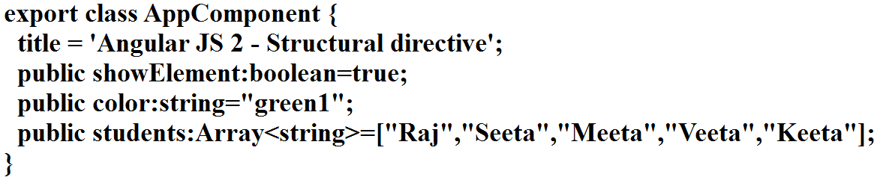
Components

Slide 44
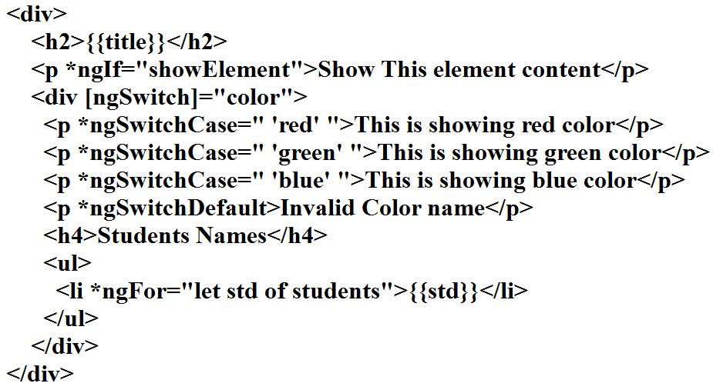
Template

Slide 45
Attribute directives
Attribute directives changes the appearance or behaviour of an element.
Attribute directives are surrounded by brackets which sign to Angular that the appearance or behaviour of the DOM elements within the directive may change depending on certain conditions.
In Angular 6 are ngStyle and ngClass are the built-in attribute directives.
In Angular 1.x there was the ng-show and ng-hide directives, which show or hide elements depending on what the given expression evaluates to by setting the display CSS property.

Slide 46
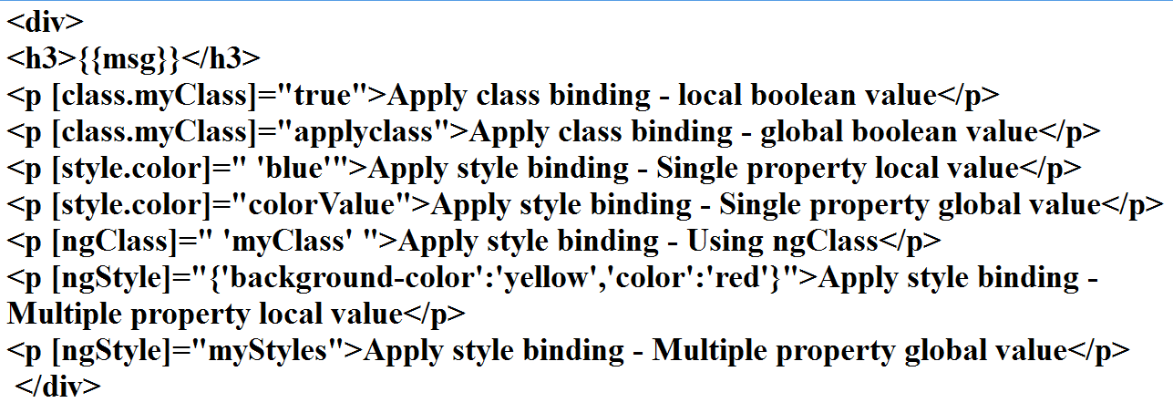
Template

Slide 47
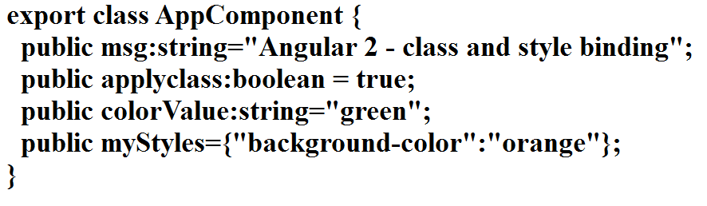
Styles
styles:[`.myClass{color:red;}`]

Slide 48
Angular 6 forms
Angular totally provided two types of forms
Template Driven Forms
Model Driven or Reactive approach Forms

Slide 49
TDF Vs MDF
Easy to use
Suitable for simple scenarios and fails for complex scenarios
Two way data binding(using [(NgModel)] syntax)
Minimal component code
More flexible, but needs a lot of practice
Handles any complex scenarios
No data binding is done
More component code and less HTML markup

Slide 50
Template driven form
When we want to use the template driven form first we have to use the FormsModule in module(AppModule).
The we have to use the ngForm Directives.
It provides use information about the current state of the form state of the form including.
A JSON representation of the form value.
Validity state of the entire form.

Slide 51
ngFormDirective
<form #formRef="ngForm" (submit)="checkValue(formRef.value)">
</form>

Slide 52
ngModel directive
In order to register form controls on an ngForm instance we use the ngModel directive.
In combination with a name attribute, ngModel creates a form control abstraction for use behind the scenes.
Every form controls that is registered with ngModel will automatically shows up in form.value

Slide 53
ngForm with ngModel
<form #formRef="ngForm" (submit)="checkValue(formRef.value)">
<input type=“text” name=“uname” ngModel>
</form>

Slide 54
ngModelGroup
<div ngModelGroup="FullName">
FirstName:<input type="text" name="fname"ngModel>
LastName:<input type="text" name="lname"ngModel>
</div>

Slide 55
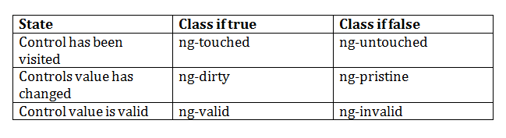
Angular pre-defined validation classes
componentRefName.errors.required
componentRefName.errors.minlength
componentRefName.errors.maxlength

Slide 56
ngForm with ngModel with Validation
<form #formObj="ngForm“ (ngSubmit)="verify(formObj.value)“ nonvalidate>
<input type="text" name="user" ngModel required #userRef="ngModel” minlength="2"/>
<div *ngIf="userRef.errors && (userRef.dirty || userRef.touched)">
<span [hidden]="!userRef.errors.required">
UserName is required
</span>
<span [hidden]="!userRef.errors.minlength">
UserName must be 2 character
</span>
</div>
<input type="submit" [disabled]="!formObj.valid">

Slide 57
Model Driven Forms
Model Driven Forms also known as Reactive forms.
In this approach, we create new instances of the form controls and form control group in our component.
When we want to use the model driven form first we have to use the ReactiveFormsModule in module(AppModule).

Slide 58
FormGroup and FormGroupControl
FormControl : The class is present in the "@angular/forms" package of Angular 2.0.Each component in form like textfield, radiobutton, checkbox is known as FormControl
FormGroup : The class is present in the "@angular/forms" package of Angular 2.0. It is used to represent a set of form control inside its constructor.

Slide 59
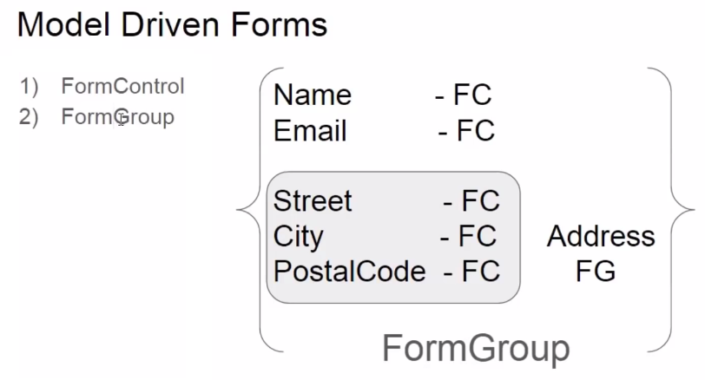

Slide 60
In Component
userForm=new FormGroup({
uname:new FormControl(),
pname:new FormControl(),
addressForm=new FormGroup({
.....
.....
})
});

Slide 61
In Template
<form [fromGroup]=“userForm”>
<input type=“text” formControlName=“uname”>
........
........
........
</form>

Slide 62
Model Driven form with Validation
Import the Validators from the ‘@angular/forms”.
Which provide set of field which help to do the validation.
userForm=new FormGroup({
uname:new FormControl(‘’,[Validators.required,Validators.minLength(3)]),
pname:new FormControl(‘’,[Validators.required,Validators.maxLength(6)]),
});

Slide 63
<form [formGroup]="loginForm" (submit)="verify()" nonvalidate>
<input type="text" formControlName="user" required/>
div *ngIf="!loginForm.controls.user?.valid && (loginForm.controls.user?.dirty
|| loginForm.controls.user?.touched)">
<div [hidden]="!loginForm.controls.user.errors.required">
UserName is required
</div>
<div [hidden]="!loginForm.controls.user.errors.minlength">
Min Length must be 2 character
</div>
</div>
<input type="submit" value="submit" [disabled]="!loginForm.valid">

Slide 64
Custom directive-Attribute directive
import required modules like Directive, ElementRef from Angular 6 core library.
Create a TypeScript class decorate the class with @directive
Set the value of the selector property in @directive decorator function. The directive would be used, using the selector value on the elements.
In the constructor of the class, inject ElementRef and Renderer object

Slide 65
Continue...
We are injecting ElementRef in the directive's constructor to access the DOM element.
We are also injecting Renderer in the directive's constructor to work with DOM's element style.
We are calling the renderer's setElementStyle function. In the function, we pass the current DOM element by using object of ElementRef.

Slide 66
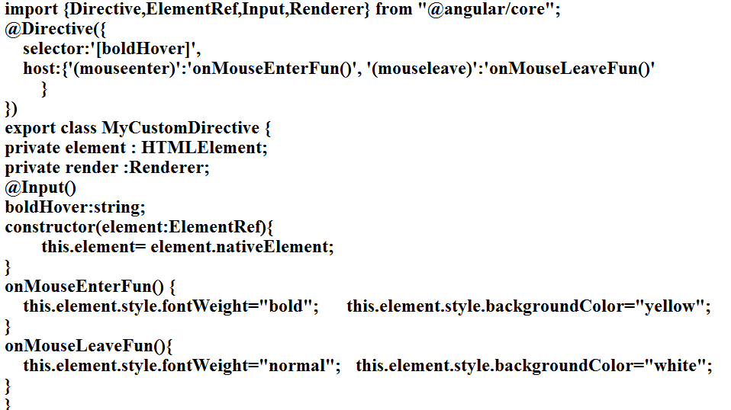

Slide 67
Template
<div>
<p [boldHover]=" 'true'">I am Here!</p>
</div>

Slide 68
Custom Structural directive
A structural directive changes the DOM layout by adding and removing DOM elements.
The three most common structural directives you will come across are ngIf, ngSwitch and ngFor.
If you want to create the custom structural directive
We requried some API
Directive, Input, TemplateRef,ViewContainerRef from "@angular/core".

Slide 69
Continue...
TemplateRef as the name suggest the TemplateRef is just a reference to the template.
ViewContainerRef : If you think about it, eventually templates contains DOM elements, so if you need to insert an element, you need a place to "put" it. In Angular, this place is called a Container. ViewContainerRef is a reference to the Container.

Slide 70
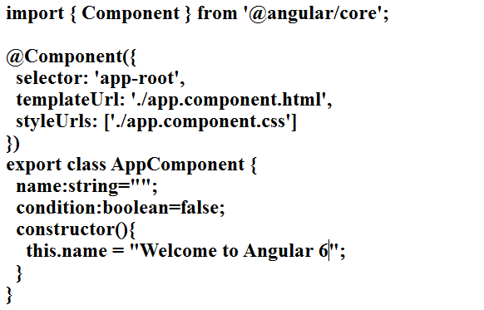
App.component.ts

Slide 71
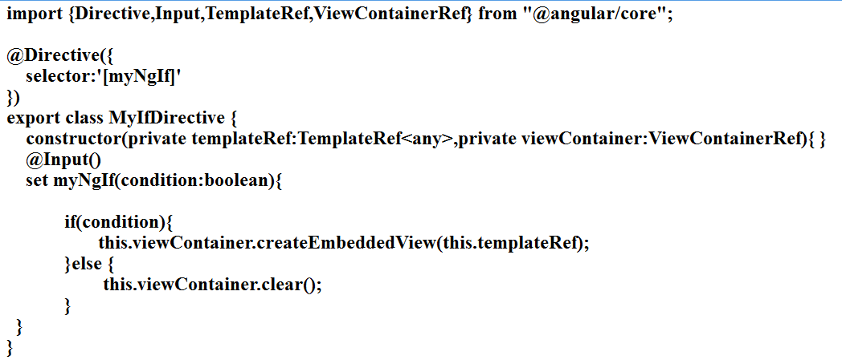
App.custom.directive.ts

Slide 72
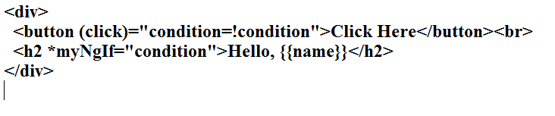
app.component.html

Slide 73
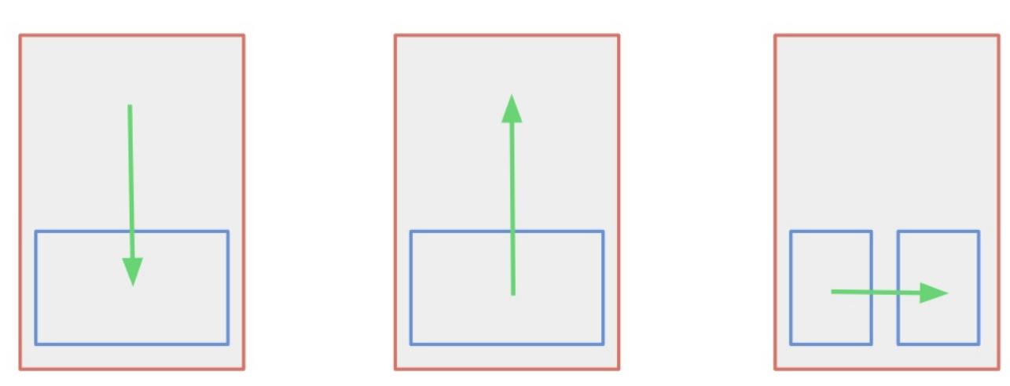
Component communication

Slide 74
Components communication
Parent to child and child to parent
Parent to Child passing the data using @Input
Child to Parent passing the data using @Output
Child to Parent passing the data @ViewChild
Passing the data between sibling
Using common Service provided by ngModule
Using common Service BehaviourSubject
Using localStorage / sessionStorage

Slide 75
Parent to child using @Input
Parent component
emp :Employee =new Employee(1,”Raj”,12000)
Child component
@Input
empRef:Employee;
Child component template
<app-child [empRef]=“emp”></app-child>

Slide 76
Child to parent using @ViewChild
ViewChild allows a one component to be injected into another, giving the parent access to its attribute and functions.
The child won't be available until after the view has been initialized.
This means we need to implement the AfterViewInit lifecycle hook to receive the data from the child.

Slide 77
Continue...
Parent component
@ViewChild(ChildComponentComponent)
childRef;
age:number;
ngAfterViewInit() {
this.age = this.childRef.empAge;
}
Child component
empAge:number=25

Slide 78
Child to parent using @Output and EventEmitter
To pass the value from child component to parent component we have to use the EventEmitter reference
To pass the value from child component to parent component we have to use the @Output decorator.

Slide 79
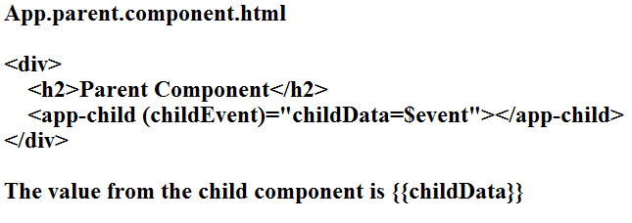
App.childcomponent.html
<input type="text" #childText (keyup)="changeValue(childText.value)">

Slide 80
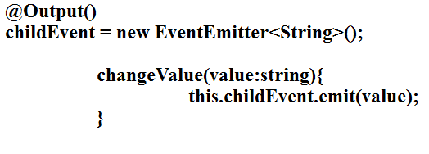
App.component.ts

Slide 81
Communication between sibling
Using Shared Service
with setter and getter
Using JavaScript objects
localStorage and sessionStorage
BehaviorSubject
Subjects are used for multicasting Observables. This means that Subjects will make sure each subscription gets the exact same value as the Observable execution is shared among the subscribers
The BehaviorSubject has the characteristic that it stores the “current” value. This means that you can always directly get the last emitted value from the BehaviorSubject.

Slide 82
Continue...
In Common Service
private msgSource = new BehaviorSubject('default msg'); currentMessage = this.msgSource.asObservable();
changeMessage(message: string) { this.msgSource.next(message) }
In Component
this.data.currentMessage.subscribe(message => this.message = message)

Slide 83
Angular pipe
In Angular 6, pipe (filter) is use to format the data.
A pipe takes in data as input and transforms it to a desired output.
So In Angular we use the | pipe character to format our data.
Currency
Date
Decimal
Json
lowercase and uppercase
percent
Async

Slide 84
Currency
The currency pipe allow to format numbers in different currencies.
{{price | currency:'CAD'}}
{{price | currency:'USD':true}}
{{price | curency :'EUR':false:3.2-1}}
{{price|currency:'&#8377'}}
The first argument is a string with the local currency code.
The second possible argument is a boolean to show the that will show either the currency symbol or the currency code. The default is false and shows the currency code.
The third possible is a string in the format of the decimal pipe to format the number.

Slide 85
Date
Format date values with the Date pipe
{{someDate | date :'medium'}}
{{someDate | date : 'fullDate'}}
{{someDate | date : 'yy'}}
{{someDate | date : ''Hm'}}
You can use a number symbol to define a custom format or you can also use a number of predefined keywords. The available keywords are following : "medium", "short", "fullDate", "longDate", "mediumDate", "shortDate", "mediumTime", "shortTime".

Slide 86
Decimal
Decimal
The Decimal pipe formats decimal values
{{ decimalvalue | number :'4.3-5'}}
In the above example, 4 is the minimum number of integer digits, 3 is for the minimum number of fraction digits and 5 is for the maximum number of fraction digits.

Slide 87
Json and upercase/lowercase
Json : The Json pipe is useful for debugging and dispalys an object as a json string. It uses JSON.stringify behind the scenses.
{{someObjet| json}}
lowercase and uppercase : Convet text to either lower case or upper case with the respective pipe.
{{user.name |upercase }}
{{user.name |lowercase}}

Slide 88
Percentage
Percet : The percet pipe transform a number into its percentage value
{{decimalValue | percent }}
Slice : Create a subset list or string with the Slice pipe
{{ someText | slice :3:6}}
<ul>
<li *ngFor="let item of someList | slice:2">
{{item }}
</li>
</ul>

Slide 89
Async
Async : The Async pipe automatically subscribes to an Observable or a Promise and returns the emitted values as they come in
<ul>
<li @ngFor="let item of data | async">
{{item.name}}
</li>
</ul>

Slide 90
Custom pipe
A custom pipe is created using a Pipe decorator on a class with a name property.
The value of the name is used as a template expression while calling custom pipe, and a class must implement PipeTransform which is inside @angular/core.
It is an interface which has transform method, which takes the values that has to be piped

Slide 91
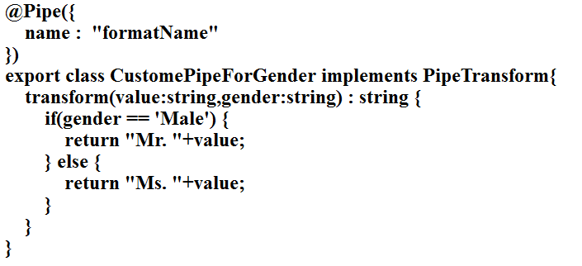
Example of custom pipe

Slide 92
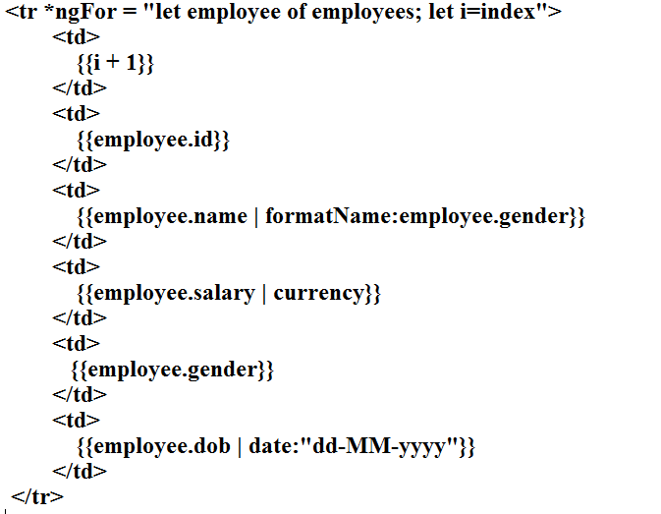
Template example

Slide 93
Lifecycle Hooks
Allow us to perform custom logic at various stages of a component's life
Data isn't always immediately available in the constructor Only available in TypeScript
The lifecycle interfaces are optional. We recommend adding them to benefit from TypeScript's strong typing and editor tooling
Implemented as class methods on the component class.

Slide 94
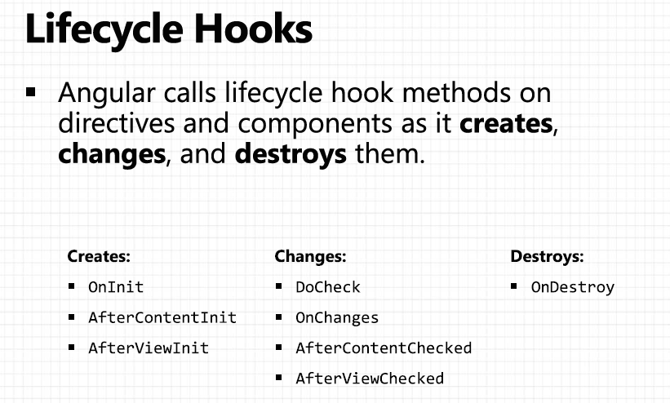

Slide 95
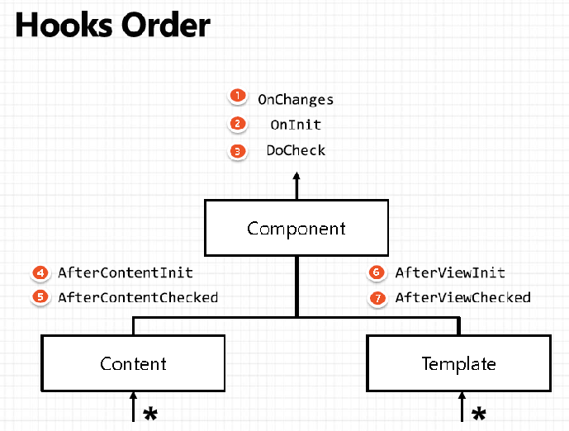

Slide 96
ngOnChanges
ngOnChanges : This event executes every time when a called when an input or output binding value changes.
Syntax
@Input
msg:string;
ngOnChanges(changes: SimpleChanges) {
console.log(“currentValue is “+changes.currentValue);
console.log(“new Value is “+changes.previousValue);
}

Slide 97
ngOnInit
ngOnInit : This event initializes after Angular first displays the data-bound properties or when the component has been initialized. This event is basically called only after the ngOnChanges()events. This event is mainly used for the initialize data in a component.

Slide 98
ngDoChech
ngDoCheck – This event is triggered every time the input properties of a component are checked. We can use this hook method to implement the check with our own logic check.
Detect and act upon changes that Angular can't or won't detect on its own.
developer's custom change detection.
Called during every change detection run, immediately after ngOnChanges()and ngOnInit().

Slide 99
ngAfterContentInit
ngAfterContentInit – after component content initialized.
Called once after the first ngDoCheck().

Slide 100
ngAfterContentChecked
ngAfterContentChecked – This lifecycle hook method executes every time the content of the component has been checked by the change detection mechanism of Angular. This method is called after the ngAfterContentInit() method. This method is also called on every subsequent execution of ngDoCheck().

Slide 101
ngAfterViewInit
ngAfterViewInit – This lifecycle hook method executes when the component’s view has been fully initialized. This method is initialized after Angular initializes the component’s view and child views.
Called once after the first ngAfterContentChecked().

Slide 102
ngAfterViewChecked
ngAfterViewChecked – This method is called after the ngAterViewInit() method. This method also executes when any binding of the children directives has been changed. So this method is very useful when the component waits for some value which is coming from its child components.
Called after the ngAfterViewInit() and every subsequent ngAfterContentChecked().

Slide 103
ngOnDestroy
ngOnDestroy – This method will be executed just before Angular destroys the components. This method is called just before the component is removed from the DOM.

Slide 104
Angular Service
Services allow for greater separation of concerns for your application and better modularity by allowing you to extract common functionality out of component.
Service is used when a common functionality need to be provided for various modules.
Angular also comes with its own dependency injection framework for resolving dependencies, so you can have your services depend on other services through out your application, and dependency injection will resolve your dependencies for you.

Slide 105
Dependency Injection
DI is a coding pattern in which a class receives its dependencies from external sources rather than creating them itself.

Slide 106
Types of Service in Angular 2
User-defined service
Pre-defined service

Slide 107
Steps to create the Service
Import the injectable member
Add the @injectable Decorator
Export Service class

Slide 108
Register the Service
We can register the service in two ways
In Component
In Module

Slide 109
In Component
There are four simple steps to use/import Service in the Component
import the Service to the component
Add it as a provider
Include it through Dependency injection
Use the Service function

Slide 110
In Module
There are four simple steps to use/import Service in the Module
import the Service to the module
Add it as a provider
Include it through Dependency injection in Component
Use the Service function

Slide 111
Angular 6 http service
One of the most common scenario in any application is client interacting with the server.
Http is the widely used protocol for this interaction.
One can fetch data from the server, update data, create data and delete data using HTTP protocol.
In Angular 2 http service return the Observable but Angular 1.x is http service return the Promise object.

Slide 112
JavaScript callback function
A callback function is a function passed into another function as an argument, which is then invoked inside the outer function to complete some kind of routine or action.
Callback function may be synchronous and asynchronous functions.

Slide 113
Synchronous and Asynchronous
In synchronous programs, if you have two lines of code (L1 followed by L2), then L2 cannot begin running until L1 has finished executing.
In asynchronous programs, you can have two lines of code (L1 followed by L2), where L1 schedules some task to be run in the future, but L2 runs before that task completes.

Slide 114
What is promise
Promise is a one type of callback function, which represents the eventual result of an operation. You can use a promise to specify what to do when an operation eventually succeeds or fails.

Slide 115
The Promise
The Promise is an object, with two functions.
then() => Promise, please get the value from that URL.
error() => Promise, please call this function when you have a new error for me.

Slide 116
Observer pattern
The observer pattern is a software design pattern in which an object, called the subject, maintains a list of its dependents, called observers, and notifies them automatically of any state changes, usually by calling one of their methods. It is mainly used to implement distributed event handling systems.

Slide 117
Observables in Angular
You can think of an observable as an array whose items arrive asynchronously over time.
Observables help you manage asynchronous data, such as data coming from a backend service. Observables are used within Angular itself, including AngularJS event system and its http client service. To use observables, Angular uses a third-party library called Reactive Extensions (RxJS). Observables are a proposed feature for ES 2016, the next version of JavaScript.

Slide 118
The Observer
The Observer is an object, with three functions.
next() => Observable, please call this function when you have a new value for me.
error() => Observable, please call this function when you have a new error for me.
complete() => Observable, please call this function when you complete your job.

Slide 119
Observable Vs Promise
Observables
Observables handle multiple values over time.
Observable are cancellable.
Promise
Promise are only called once and will return a single value.
Promises are not cancellable.

Slide 120
What is RxJS
RxJS or Reactive Extensions for JavaScript is a library for transforming, composing, and querying streams of data.
We mean all kinds of data too, from simple arrays of values, to series of events
RxJS can be used both in the browser or in the server-side using Node.js.
Asynchronous, in JavaScript means we can call a function and register a callback to be notified when results are available.
Data, raw information in the form of JavaScript data types as: Number, String, Objects (Arrays, Sets, Maps).
Streams, sequences of data made available over time.

Slide 121
Demo Example
var Rx=require("rx");
var source = Rx.Observable.range(1,5);
var sub = source.subscribe(
x=>console.log(x),
e=>console.log(e),
()=>console.log("completed")
)

Slide 122
http service
http:- It is for callback, used for performing XMLHttpRequest operations like get(), post(), delete(), put(),
All the Http methods return Observable, from Observable we use an operator map() to manipulate the data, the data would be in a Response which you get once you call subscribe() method
map(res => response.text())
map(res => response.json())
The map would get the response once the subscribe() is called however the response must be assigned to a class property such that it can be displayed finally

Slide 123
HttpClient Module
New module introduced in angular 4 which is available as HttpClient Module. Available parallely in angular/common/http.

Slide 124
Main Features
Typed, synchronous response body access, including support for JSON body types
JSON is an assumed default and no longer needs to be explicitly parsed
Interceptors allow middleware logic to be inserted into the pipeline
Immutable request/response objects

Slide 125
Json as a default
JSON is an assumed default and no longer needs to be explicitly parsed.
Earlier
http.get(url).map(res=>
res.json()).subscribe(....)
Now
http.get(url).subscribe(...)

Slide 126
For non-Json data
●
We have to specify the response type http
.get('/textfile.txt', {responseType: 'text'})
.subscribe(data => console.log(data));
●

Slide 127
Setting up the params and headers
●
Setting up the headers http.post('/api/items/add', body, {
headers: new HttpHeaders().set('Authorization', 'my-auth-token'),
}) .subscribe();
Setting up the params
http.post('/api/items/add', body, params: new HttpParams().set('id', '3'),}).subscribe();
●
●
●

Slide 128
HttpClient with pipe() methods
Observable works asynchronously and once there is an error in Observable for any element then it stops emitting other values. To handle Observable error, we can use catchError operator of Reactive JS as well as if we want to try to hit the connection again and again then we can use the retry() operator.
When we want to use rxjs operator we have to wrap this one in the pipe() operators.

Slide 129
Example
this.httpClient.get(url).pipe(retry(3),
catchError(this.myError)).subscribe(data=>console.log(data));

Slide 130
myError function
myError(obj:HttpErrorResponse) {
if (obj.error instanceof ErrorEvent) {
// A client-side or network error occurred. Handle it accordingly.
console.error('An error occurred:', obj.error.message);
} else {
// The backend returned an unsuccessful response code.
// The response body may contain clues as to what went wrong,
console.error(`Backend returned code ${obj.status}, ` +
`body was: ${obj.error}`);}
// return an observable with a user-facing error message
return throwError('Something bad happened; please try again later.');
}

Slide 131
Material design
Material Design is a design language for web and mobile apps which was developed by Google in 2014.
Material Design makes it easy for developers to customize their UI while still keeping a good-looking app interface that users are comfortable with.

Slide 132
Angular material
Angular Material consists of a suite of pre-built Angular components.
Unlike Bootstrap, which gives you components that you can style any way you want, Angular Material strives to provide an enhanced and consistent user experience.
At the same time, it gives you the ability to control how different components behave.

Slide 133
Angular material add
In order to add Angular Material to a project, we will use the ng add command which is used to add new capabilities to Angular projects.
ng add @angular/material
This command will add the library to an existing project and bring in theme CSS in angular.json. It will also add scripts in index.html and update the AppModule.

Slide 134
Angular material Dependencies and components
Form controls
Buttons and indicators
Navigation and layout
Popups and modals
Data table

Slide 135
Starter material components
Navigation
ng generate @angular/material:material-table --name componentName
Dashboard
ng generate @angular/material:material-nav --name componentName
Table
ng generate @angular/material:material-dashboard --name componentName

Slide 136
Routing
Routing helps to direct to different pages based on the options user select, using Routing you can render components to the users based on the options they select.
So the browser doesn’t load the whole page instead it only loads the component which we selected at runtime;

Slide 137
Steps to create the routing
Create the .ts routing file (app.routing.ts)
Import the NgModule from @angular/core, Routes and RouterModule from @angular/router' and all component which want to route at runtime.
Now we have to create the variable of type Routes. Which contains path and component property based upon the number of component want to route.

Slide 138
Syntax
const routes:Routes=[
{ path: '', redirectTo: 'home', pathMatch: 'full' },
{ path: 'home', component: Home },
{ path: ‘about', component: AboutUs },
{ path: ‘contact', component: ContactUs },
{ path: '**', component: NotFound }, //always last
]

Slide 139
Continue...
Then create the class with @ngModule and use the two properties as import and export.
With following syntax
imports:[RouterModule.forRoot(routes)],
exports:[RouterModule]

Slide 140
In template
<div>
<a routerLink=“[‘/home’]">Home Page</a>
<a routerLink=“[‘/about’]">About Us</a>
<a routerLink=“[‘/contact’]">Contact Us</a>
</div>
<div>
<router-outlet></router-outlet>
</div>

Slide 141
Child Routes

Slide 142
const usersRoutes: Routes = [
{ path: 'users', component: Users },
{ path: 'users/:id', component: User }
];
Or
const usersRoutes: Routes = [
{ path: 'users',
children: [
{ path: '', component: Users },
{ path: ':id', component: User }
]
}];

Slide 143
Navigation
Using routerLink directive
['users', 34] /users/:id
Programatically
router.navigate(['users', 34])
router.navigateByUrl('/users/34')
Example
<a [routerLink]="['users', 34]">User Info</a>

Slide 144
In Template
<h1>Users</h1>
<tr *ngFor="let user of users">
<td>
<a [routerLink]="['/users',user.id]">{{user.username}}</a>
</td>
</tr>

Slide 145
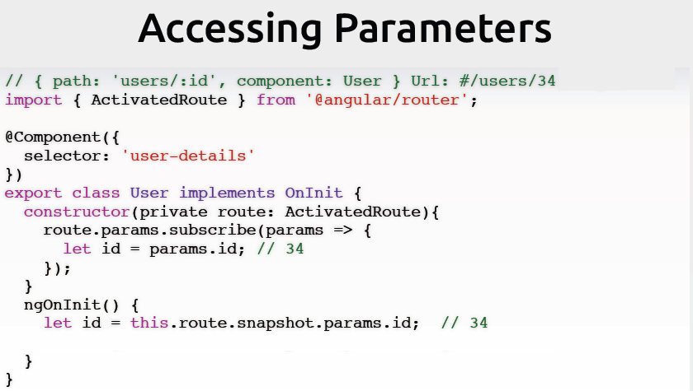

Slide 146
Navigation Guards

Slide 147
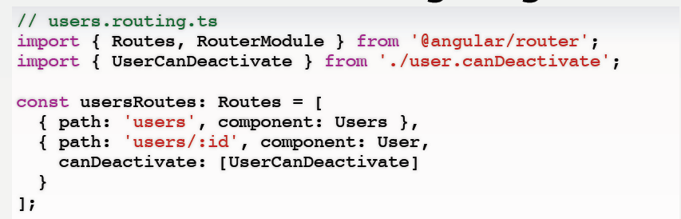
Ask before navigating

Slide 148
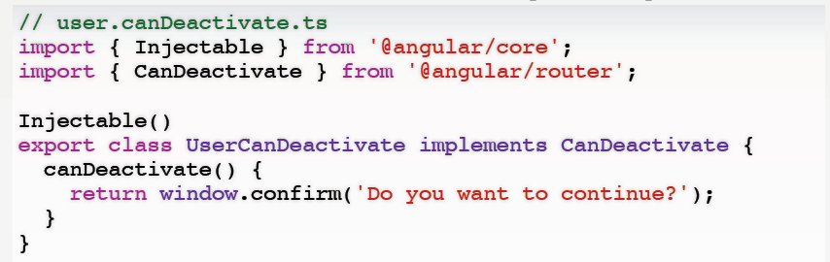

Slide 149
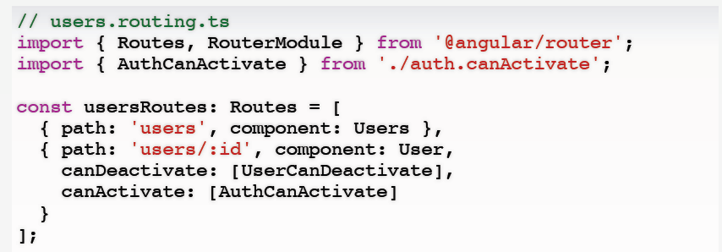
Restrict Access

Slide 150
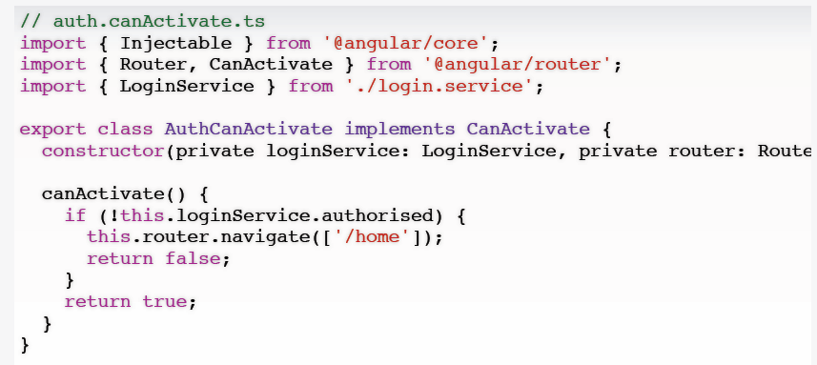
Restrict Access

Slide 151
Angular module loading
In Angular module can loaded eagerly, lazily, and preloaded.
The application module i.e. AppModule is loaded eagerly before application starts. But the feature modules can be loaded either eagerly or lazily or preloaded.
Eager loading: To load a feature module eagerly we need to import it into application module using importsmetadata of @NgModule decorator.
Eager loading is useful in small size applications.

Slide 152
Continue...
Lazy loading: To load a feature module lazily we need to load it using loadChildren property in route configuration and that feature module must not be imported in application module.
Lazy loading is useful when the application size is growing.
Preloading: To preload a feature module we need to load it using loadChildren property and configure preloading Strategy property with RouterModule.forRoot.
That feature module must not be imported in application module.
we need to use custom preloading strategy.

Slide 153
Project structure
Main module and main component
app.module.ts
app.component.ts
app.routing.module.ts
Sub1 module
sub1module.module.ts
com1.component.ts
route1.routing.module.ts
Sub2 module
sub2module.module.ts
com2.component.ts
route2.routing.module.ts

Slide 154
Commands to generate modules and component s
Create a feature module with routing
ng generate module sub1module –routing
Or
ng g m sub1module –routing
Add a component to the feature module
ng generate component com1/sub1module
Or
ng g c com1/sub1module

Slide 155
Change detection Strategy
Change Detection means updating the view (DOM) when the data has changed.
The basic mechanism of the change detection is to perform checks against two states, one is the current state, the other is the new state.

Slide 156
Change detection is done in two steps
Update the application model (developer);
Reflect the state of the model in the view (Angular).
The way Angular runs the change detection by starting from the top and continuing until it reaches the bottom, makes the system more predictable.

Slide 157
Angular Change detection strategy
Type of strategy are
Default
By default, Angular has to be conservative and will checks every time something may have changed, this is called dirty checking.
onPush

Slide 158
We can control the detection
Using
Observables.
Immutable Objects
ChangeDetectorRef

Slide 159
Continue....
Each component has its own change detector
By default is ChangeDetectionStrategy.DEFAULT
We can use
ChangeDetectionStrategy.OnPush along
with immutable objects and/or observables.
We can tell Angular to check a particular component by injecting ChangeDetectorRef and calling markForCheck() inside the component

Slide 160
app.component.html
<div>
Names :<input #nameRef type="text" name="user">
<br>
<input type="button" value="store“ (click)="store(nameRef.value)">
<hr>
<app-child [parentData]="names"></app-child>
</div>

Slide 161
App.component.ts
names:string[]=[];
store(name){
this.names.push(name);
}
child.component.html
<div>
Names are :
<ul *ngFor="let data of loadValues">
<li>{{data}}</li>
</ul>
</div>
child.component.ts
@Input()
parentData:string[]=[];

Slide 162
ChangeDetectionStrategy.OnPush
Using immutable objects.
//this.names.push(name);
this.names = [...this.names,name];
Immutables object - regenerate each time new objects.

Slide 163
In child component we have refresh data
constructor(public changeRef:ChangeDetectorRef) { }
loadData() {
this.changeRef.detectChanges();
}

Slide 164
Using BehaviourSubject
In app.component.html
names=new BehaviorSubject([""]);
store(name){
this.names.next(name);
}

Slide 165
In child components
@Input()
parentData:Observable<any>;
loadValues:string[]=[];
In life cycle methods
ngOnInit() {
this.parentData.subscribe(values=>{
this.loadValues=[...this.loadValues, ...values]
this.changeRef.markForCheck();
});
}

Slide 166
What is zone.js
Zone.js is a library written by the Angular team that is inspired by DART.
It provides a mechanism for encapsulating and intercepting asynchronous activities in the browser.
Useful for accessing data which persists across async operations.
Useful for framework/application to be able to schedule and intercepts async tasks.

Slide 167
Asynchronous task
An asynchronous task is a task that runs outside of the normal flow of the program.
The program will go on executing without waiting for the asynchronous tasks to finish.
When the async task does finish the application can handle it through the use of something like a callback
All asynchronous tasks in Javascript are added to an event queue, and tasks in the event queue are executed by the event loop when there is time

Slide 168
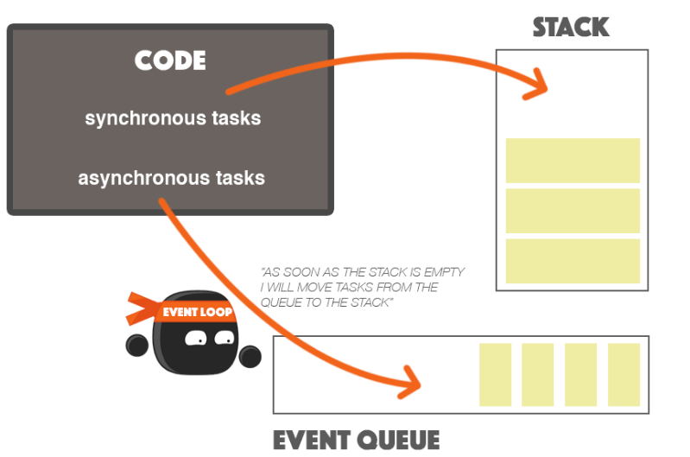

Slide 169
Continue...
A thread is a bit of code that can run independently of other bits of code that may be running at the same time.
So a “thread” is somewhat similar to an asynchronous task in JavaScript, in that it doesn’t run in line with other tasks.
You can think of zones as a way for the JavaScript engine to create spaces to run code independently of other bits of code.

Slide 170
Zone
A zone is an execution context that persists across asynchronous task.
It allows us to control execution to the code within the zone.
The library monkey patches all the async browser APIs.
Redirects all the async operation through a zone of interception.

Slide 171
Monkey patch
Monkey patching is a technique to add, modify, or suppress the default behavior of a piece of code at runtime without changing its original source code.

Slide 172
Angular uses Zone.js
Zone.js provides a mechanism, called zones, for encapsulating and intercepting asynchronous activities in the browser. (ex. setTimeout, promise, Observable)
Provides a global zone which can extended.

Slide 173
NgZone
Angular extends the global zone of the Zone.js and adds its own behaviours using NgZone service.
What notify ZoneJS and changes application state.
Events: click, dblclick, mouseover, mouseout etc
XHR : XML HttpRequest ie Http call using get, post, put or delete
Timers: setTimeOut(), setInterval()

Slide 174
Running things outside NgZone
Sometimes you would like to run the things outside of Angular. Well NgZone provides a methods named runOutside Angular.

Slide 175
App.component.html
<p>Progress: {{task}}%</p>
<p *ngIf="task >= 100">
Done processing {{msg}} of Angular zone!
</p>
<button (click)="AngularZone()">Angular Zone</button>
<button (click)="NgZone()">NgZone</button>

Slide 176
Declaration and DI for NgZone
task: number = 0;
msg: string;
constructor(private zone: NgZone) {}

Slide 177
Angular zone methods
AngularZone() {
this.msg = 'inside';
this.task = 0;
this.increaseValue(() => console.log('Inside Done!'));
}

Slide 178
NgZone methods
NgZone() {
this.msg = 'outside';
this.task = 0;
this.zone.runOutsideAngular(() => {
this.increaseValue(() => {
this.zone.run(() => { console.log('Outside Done!')
});
});
});
}

Slide 179
Asynchronous increment methods
increaseValue(doneCallback) {
this.task += 1;
console.log(`Current progress: ${this.task}%`);
if (this.task < 100) {
window.setTimeout(() => {
this.increaseValue(doneCallback);
}, 10);
} else {
doneCallback();
}
}

Slide 180
Web Worker

Slide 181
Web Worker
When executing scripts in an HTML page, the page becomes unresponsive until the script is finished.
A web worker is a JavaScript that runs in the background, independently of other scripts, without affecting the performance of the page. You can continue to do whatever you want. clicking, selecting things etc. While the web worker runs in the background.

Slide 182
Web Worker Vs Service worker
Web workers are the most general purpose type of worker. Web Worker is use run scripts in background threads.
Service workers essentially act as proxy servers that sit between web applications, the browser, and the network (when available).

Slide 183
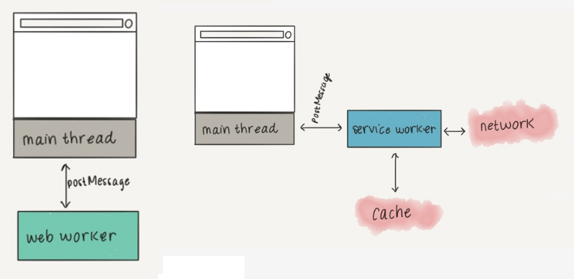

Slide 184
demo_worker.js
var i = 0;
timeCount();
function timeCount() {
i = i+1;
postMessage(i);
setTimeOut("timeCount()",1000);
}

Slide 185
Continue...
The important part of the code above is the postMessage() method, which is used to post a message back to the HTML page.
Note: Normally we worker are not used for such simple script, but for more CPU intensive tasks.

Slide 186
Continue...
var w
if(typeof(w)=="undefined") {
w =new Worker("demo_worker.js");
}
w.onmessage = function(event){
document.getElementById("result").innerHTML=event.data
}

Slide 187
Continue...
When the Web Worker posts a message, the code within the event listener is executed. The data from the Web Worker is stored in event.data.

Slide 188
Terminate web worker
When as Web Worker object is created, it will continue to listen for messages (even after the external script is finished) until it is terminated.
To terminate a web worker, and free browser/computer resources, use the terminate() method.
w.terminate();

Slide 189
Web Worker use
Lot of tasks
Infinite switch statement
Several workers.
Too much message stubs
Heavy dom
Consuming UI

Slide 190
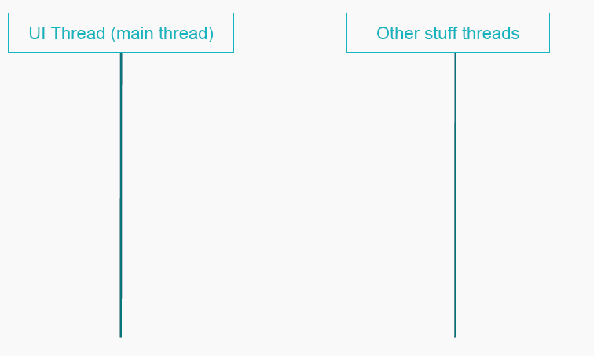

Slide 191
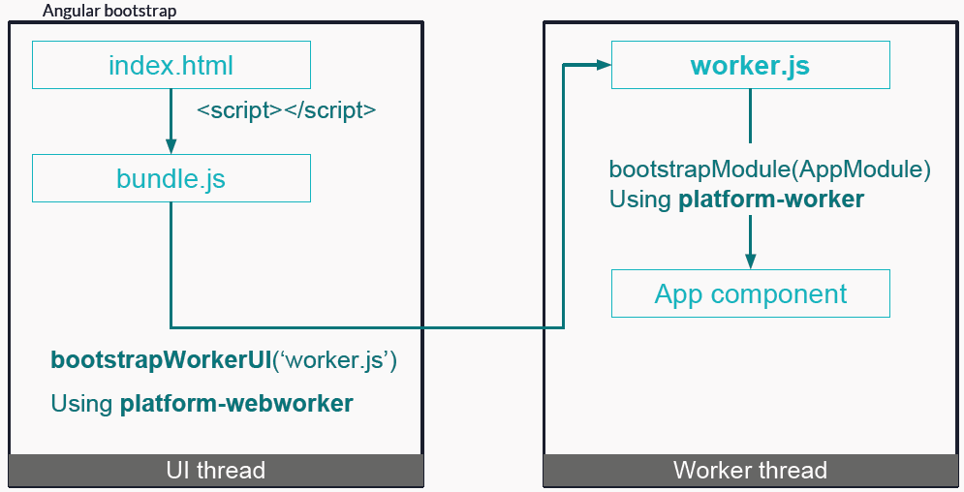

Slide 192
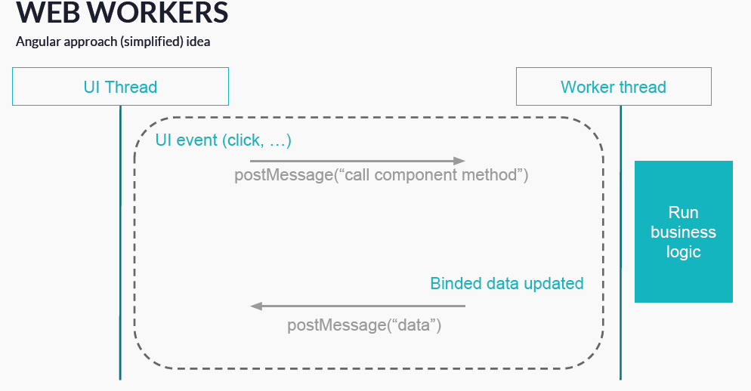

Slide 193
Web Worker configure with Angular
npm i ngx-web-worker

Slide 194
App.component.ts
Get the DI for the WebWorkerService
import { WebWorkerService } from 'ngx-web-worker';
constructor(public webWorker:WebWorkerService){}

Slide 195
Simple logic
ngOnInit() {
let input = 2;
let promise = this.webWorker.run(this.someCPUHeavyWork, input);
promise.then(result => console.log(result));
}
someCPUHeavyWork (input) {
return input*input
}

Slide 196
Optimization
AOT: (Ahead of time compilation)As opposed to JIT Compilation where the compilation is done in the browser, AOT compiles much of the code during the build process (also called offline compilation) thus reducing much of the processing overhead on the client browser. With angular-cli just specify the “aot” flag (if prod flag is present, then aot flag not required) and AOT will be enabled.
ng build –aot = true
By default when you run the ng build it is consider as development environment. But if you want production environment then we have to use the command as
ng build –prod

Slide 197
Continue...
Prod flag: For the production, build specify the “prod” flag in the angular-cli application. It will enable various build optimizations like uglify, AOT, removal of sourcemaps, service workers (if enabled) producing a much smaller build size.
Build-optimizer flag: If you are using angular-cli make sure you specify “build-optimizer” flag for your production build. This will disable the vendor chunk and will result in more smaller code.

Slide 198
Continue...
Lazy loading: Lazy loading is the mechanism where instead of loading complete app, we load only the modules which are required at the moment thereby reducing the initial load time. In simple words, it means “don’t load something which you don’t need.”
Server side rendering: Rendering the first page of your application on the server (using Node.js, .Net, PHP) and serving it as a static page causes near to instant rendering thus greatly improves perceived performance, speed, and overall user experience. You can use Angular Universal to perform server side rendering.

Slide 199
Continue...
Progressive Web App: PWA makes your app load much faster, it gives the offline capability to your app and gives near native app experience thus greatly improving overall perceived performance by the user.
Updating Angular and angular-cli: Updating your Angular and angular-cli regularly gives you the benefit of many performance optimizations, bug fixes, new features, security etc.

Slide 200
Continue...
Third party packages: Review the third party packages you are using and see if better and smaller alternative is available as it may reduce the final size of your build.
Change Detection: By default on each asynchronous event, Angular performs a dirty checking by performing a change detection for the whole component tree. Such dirty checking could be a lot computation heavy for a medium to large apps. You can drastically reduce the change detection by setting “ChangeDetectionStrategy” to “OnPush”. The OnPush strategy promotes the use of immutable data structures.

Slide 201
Continue...
@Component({
selector: 'app-demo',
templateUrl: './demo.component.html', changeDetection: ChangeDetectionStrategy.OnPush}
)

Slide 202
Continue...
Detach Change Detector: We can completely detach the component from change detection thereby giving a developer the control to inform Angular as to when and where to perform the change detection.

Slide 203
Continue...
Web Workers: The JavaScript implementation in all browser is single threaded thus making the whole app to run on a single thread. Such single-threaded execution drastically reduces the frame rate of the complex application as both UI painting and JS execution handled by the same thread. As Angular by default avoids direct DOM manipulation, it is possible to run the entire Angular app in a separate web worker thread thereby keeping the main thread free to just handle the UI rendering.

Slide 204
Deploy the project in external server
Once we created the application from Angular-CLI, we get all the configurations in the project itself for developing an app whose size will be almost 160MB or more.
but when we deploy these applications on the server we need the build files which can process the requests from the client whose size will be less than 1MB, to build the applications and deploy in Tomcat server or any web server.
ng build

Slide 205
After ng build, you can see there is dist folder will create then folder we have to copy and paste in server. It may be web server or application server.
ng build --base-href=/angular/
ng invokes angular
build asks angular to build current app
–base-href tells angular to create a reference directory where generated index.html file will be placed. So, in current case, generated files need to be placed in /angular folder in tomcat directory structure.

